Slide 1

INSTAGRAM USER ANALYTICS
SQL Fundamentals
SUBMITTED BY -
Akash Kumar

Slide 2
ABSTRACT
This project contains User Analytics , it is a process actually how users
engage and interact with our digital product .
The insights which we get through the analysis are then used by teams across this
business to launch new marketing campaign .
This Data Analysis process actually plays a role of making the task easy and effective and bring creativity for new marketing campaign.

Slide 3
Task
I have been given a Dataset which has all the data for users ,likes,posts ,comments etc .
The marketing team wants some insights for their new campaigns.
I should also give some insights regarding our product’s performance and not become like Facebook.

Slide 4
Approach
I will first create a database named ig_clone.
Then I will be creating 7 tables named users,photo,follows,comments,likes,tags,
And after that I will query my data using SQL for data analysis .
I will be using MYSQL Workbench 8.0 software. The purpose of using this software is that it is a popular , time-tested and fully-operated relational Data Base Management software .

Slide 5
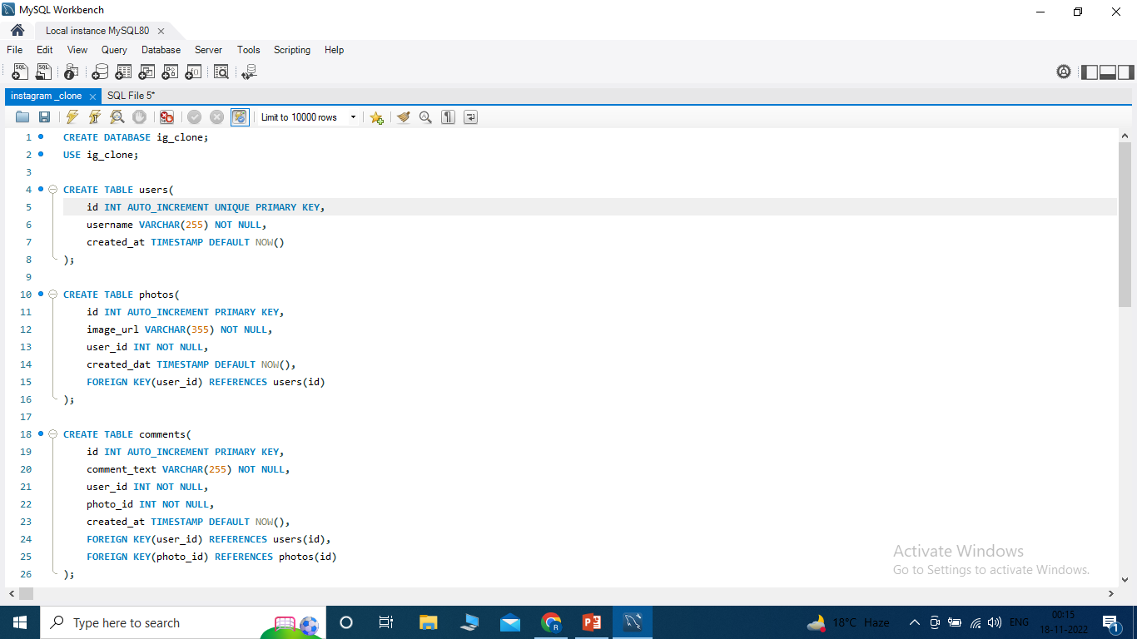
Database Creation
I am going to create my database from the given Dataset before doing Data analysis.

Slide 6
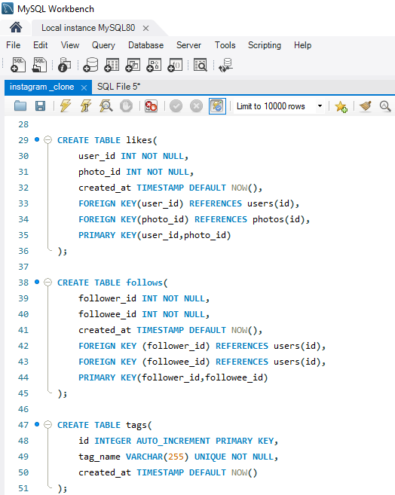
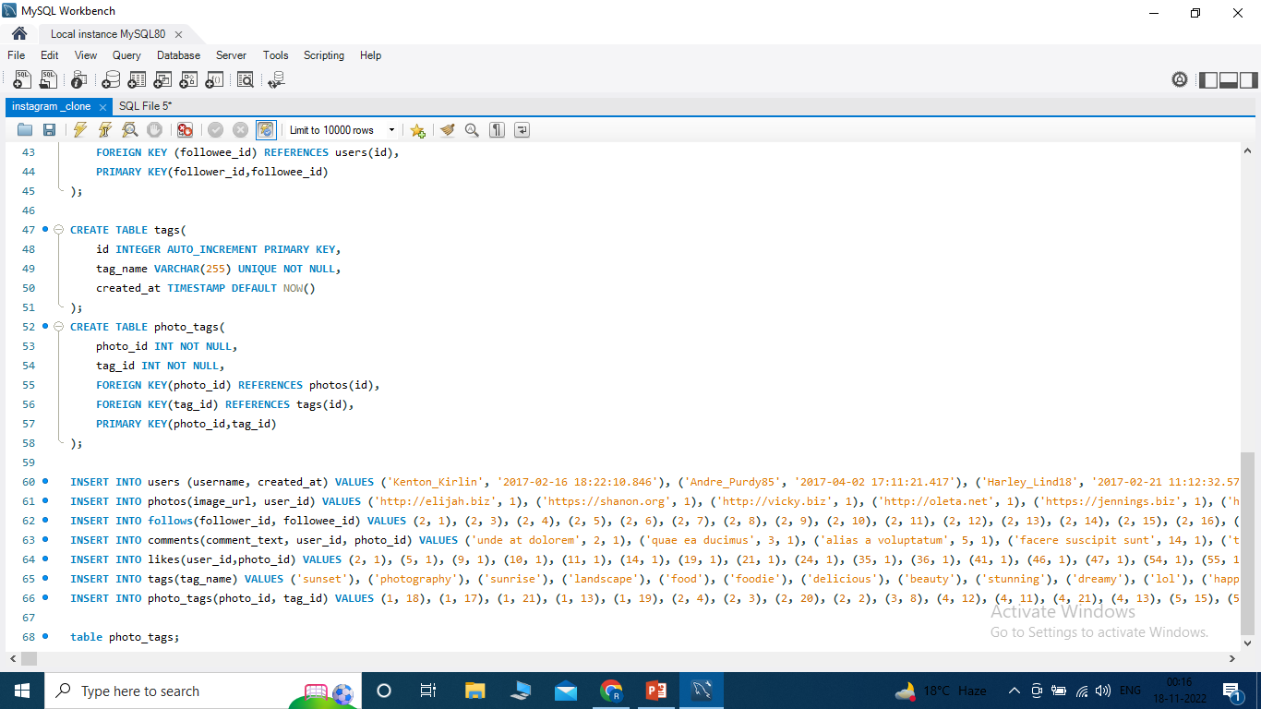
The above images are the queries done for creating the database

Slide 7
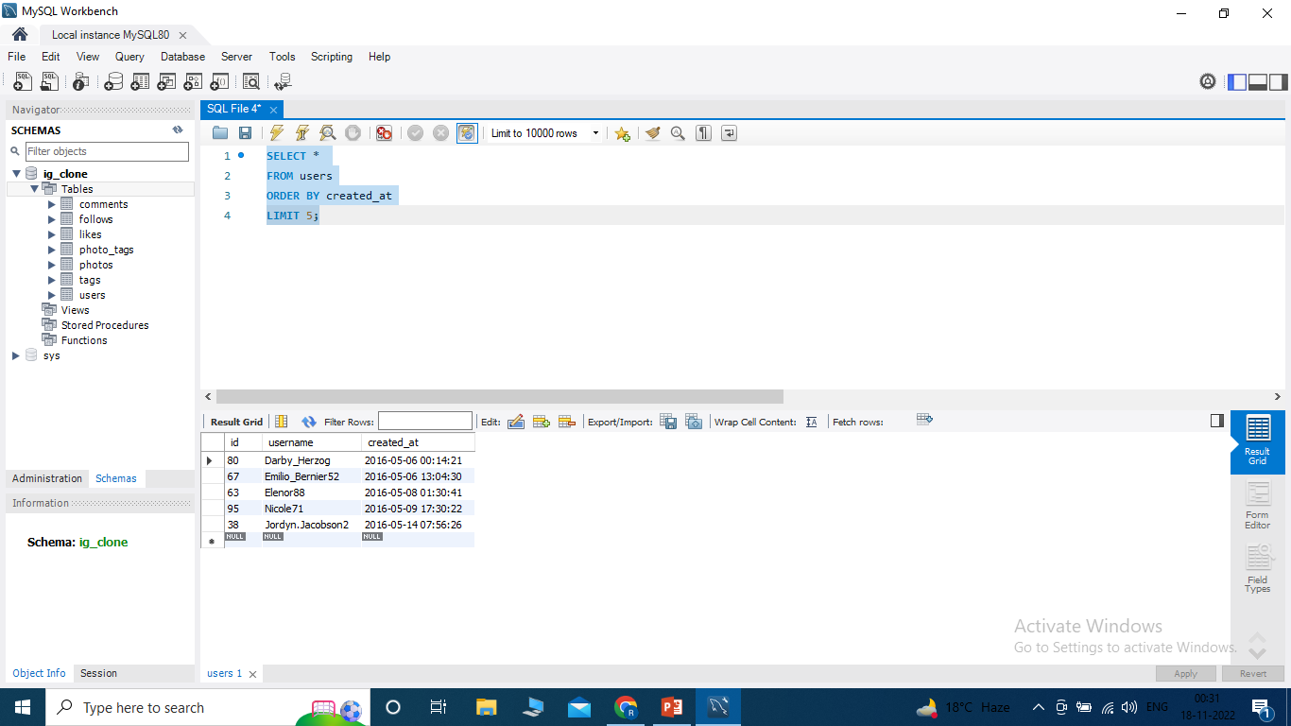
Data Analysis
A)Marketing
i) In the above SQL Query I have tried to find the top 5 oldest users of Instagram from the database .These people have been using Instagram from the longest time . This might help us in rewarding our most loyal users. The user ids are:- 80 , 67 , 63 , 95 , 38

Slide 8
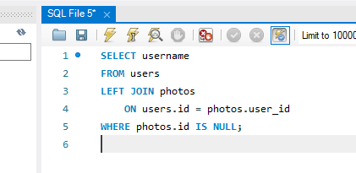
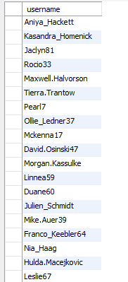
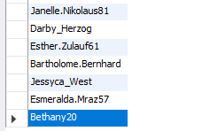
ii) The above Query tells us that there are a total of 26 users who haven’t posted a single photograph on the Instagram. So we can remind them by sending them promotional emails to post their 1st photo .

Slide 9
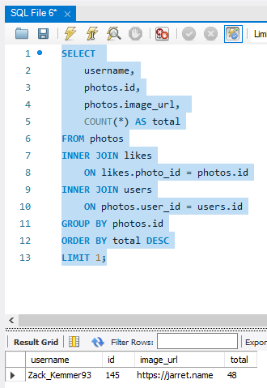
iii) The image of SQL Query above helps us to declare the winner of the contest with most number of Likes .
The details of the winners are as follows :-
Username:- Zack_Kemmer93
Id :- 145
Image_url :- https://jarret.name
Total :- 48 Likes

Slide 10
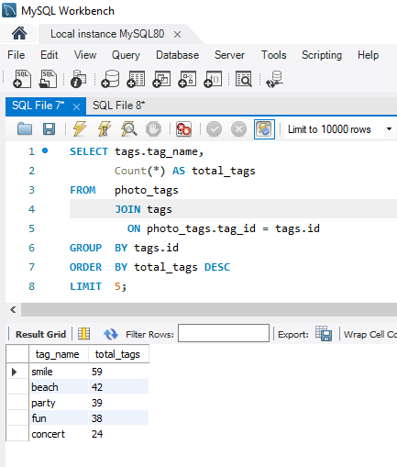
iv) The image of SQL Query above helps us to identify and suggest the top 5 most commonly used hashtags on the platform. This will help the partner brands to reach the most people on platform.

Slide 11
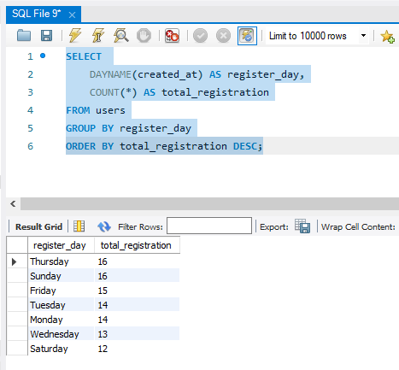
v) The image of SQL Query above helps us to identify the days on which most users register . By the above result , we can see that most users registered mostly on Thursday and Sunday . So we can say that , the marketing team can schedule the ad campaign either on Thursday or Sunday.

Slide 12
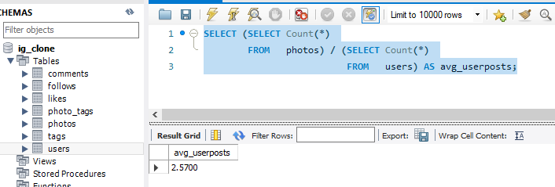
B)Investor Metrics
i) In the above SQL Query the insights tells us about the user engagement . Here we can say that an average user only posts around 3 photos on Instagram .

Slide 13
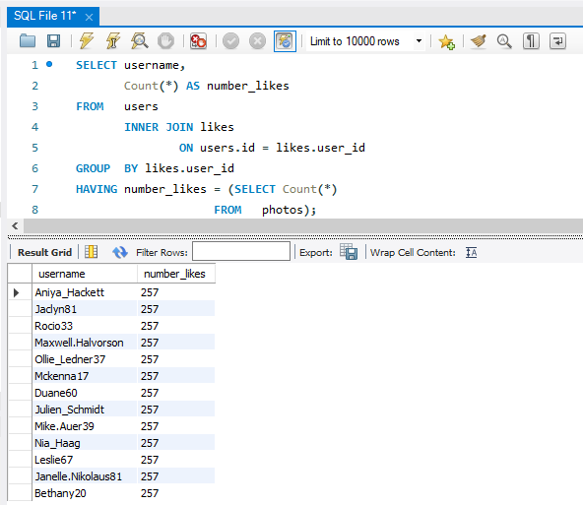
ii) In the above SQL Query the insights tells us about the BOT and Fake accounts on Instagram , who have liked every single photo on the site (since any normal user would not be able to do this).

Slide 14
Key conclusions
For marketing :-
We have to first send the promotional e-mails and encourage the inactive users to post their 1st photo.
We have to keep organizing some contest and giveaways to attract more users for Instagram .
We have to launch our Add campaigns mostly on Thursday or Sunday.
For Investor Metrics:-
We have got the details of the user engagement and we need to promote more campaigns for the increase of posts.
We also need to keep check on the Bot and Fake accounts.

Slide 15
Results
The above project has helped me and given some insights about data analysis process. It has actually helped me to understand the concept of basic SQL fundamentals . This project can help me to evolve more as a data analyst.

